Slide 1
ARITHMETIC LOGIC UNIT (ALU)

Slide 2

PRESENTED BY PRESENTED TO
NAME: SHEIKH NAFEZ SADNAN SHAMMI AKHTAR
ID:20101106 ASSISTANT PROFESSOR
SEC: B(2) DEPARTMENT OF CSE
DEPT:CSE UNIVERSITY OF ASIA PACIFIC

Slide 3
—John von Neumann
“If people do not believe that mathematics is simple, it is only because they do not realize how complicated life is.”

Slide 4
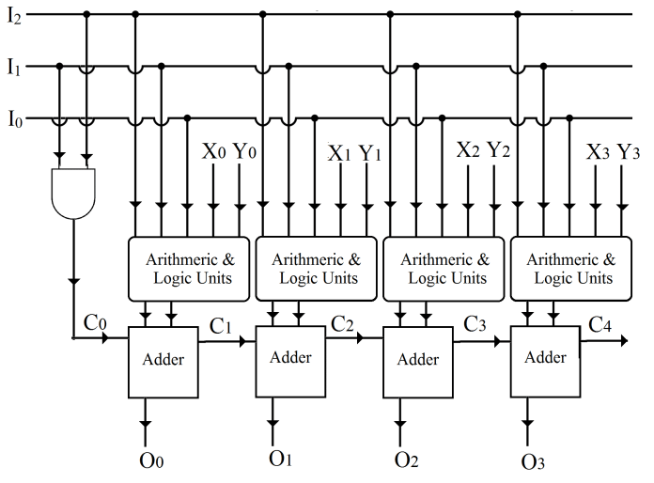
ABOUT ALU
Arithmetic Logic Unit (ALU) is the part of a computer that performs arithmetic operations on binary numbers. It is a digital circuit to do arithmetic operations like addition, subtraction, division, multiplication and logical operations like or, xor, and, not etc.

Slide 5
TABLE OF CONTENTS
01
02
HISTORY
COMPONENTS
03
04
4-BIT EXAMPLE
SUMMARY

Slide 6
HISTORY
Mathematician John von Neumann proposed the ALU concept in 1945 in a report on the foundations for a new computer called the EDVAC. The cost, size, and power consumption of electronic circuitry was relatively high throughout the infancy of the information age.
In 1967, Fairchild introduced the first ALU implemented as an integrated circuit, the Fairchild 3800, consisting of an eight-bit ALU with accumulator.
In early 1970s, 74181 ALU implemented as a 7400 series TTL integrated circuit.

Slide 7
CONCEPT
IMPLEMENTATION
4-BIT ALU
1945
1967
1970
The 74181 is a 4-bit ALU implemented as a 7400 series TTL integrated circuit.
By Mathematician John von Neumann
Fairchild 3800, consisting of an eight-bit ALU with accumulator

Slide 8
COMPONENTS
A typical ALU consists of three types of functional parts:
Storage Registers
Operations Logic
Sequencing Logic

Slide 9
Instruments
IC
Simulation Kit
Gates
Wires
IC-7483
Trainer board/ simulation software
1
2
3
4
Different input and, or, not, xor gates
Wires to construct the circuit

Slide 10
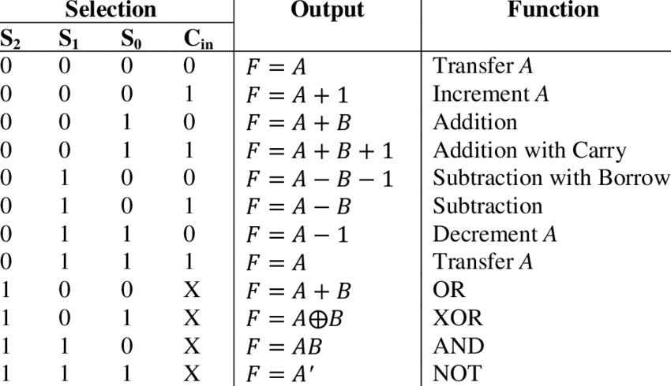
4-BIT EXAMPLE
Function Table:

Slide 11
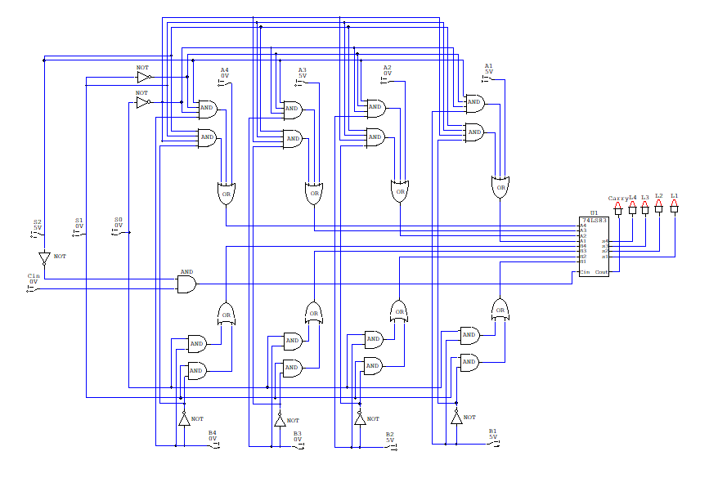
Circuit Diagram
Using IC-7483:

Slide 12
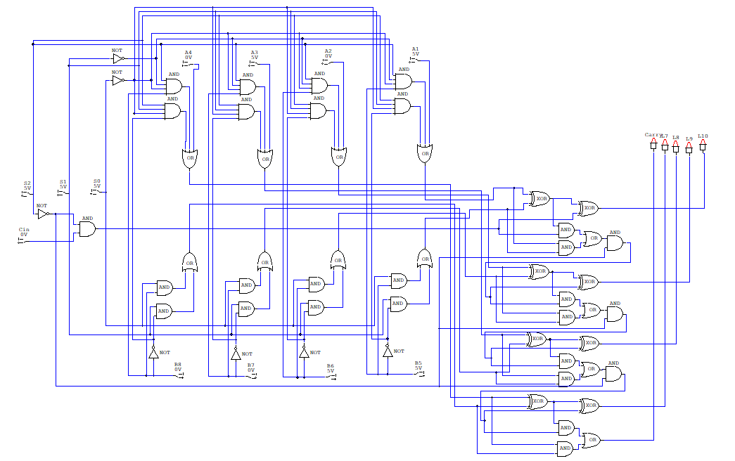
Circuit Diagram
Using Full Adder:

Slide 13
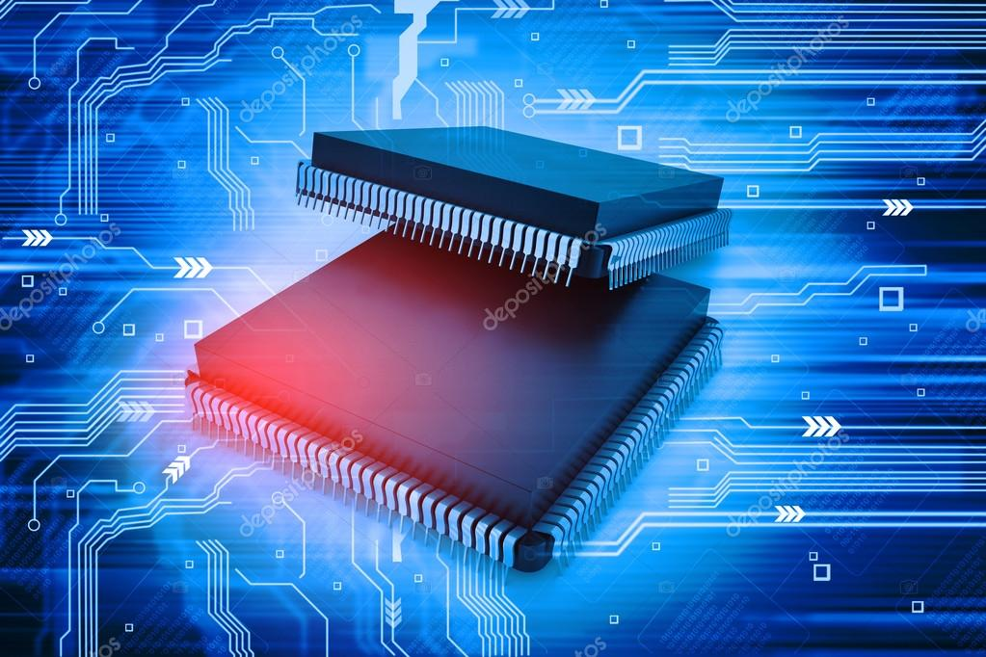
SUMMARY
Here, 8 operations of AU can be constructed using UC-7483. Also 4 LU operations can be constricted using full adders.

Slide 14
THANKS!
Do you have any questions?
20101106@uap-bd.edu

